Slide 1
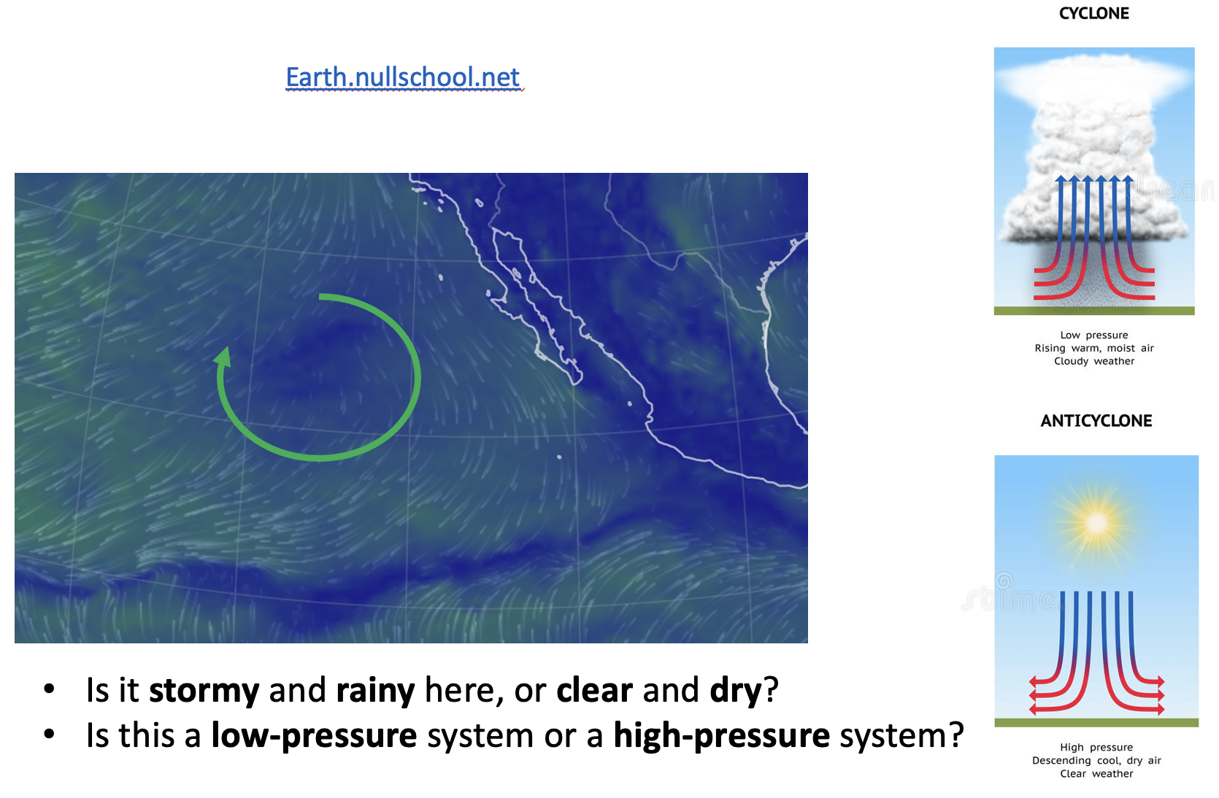
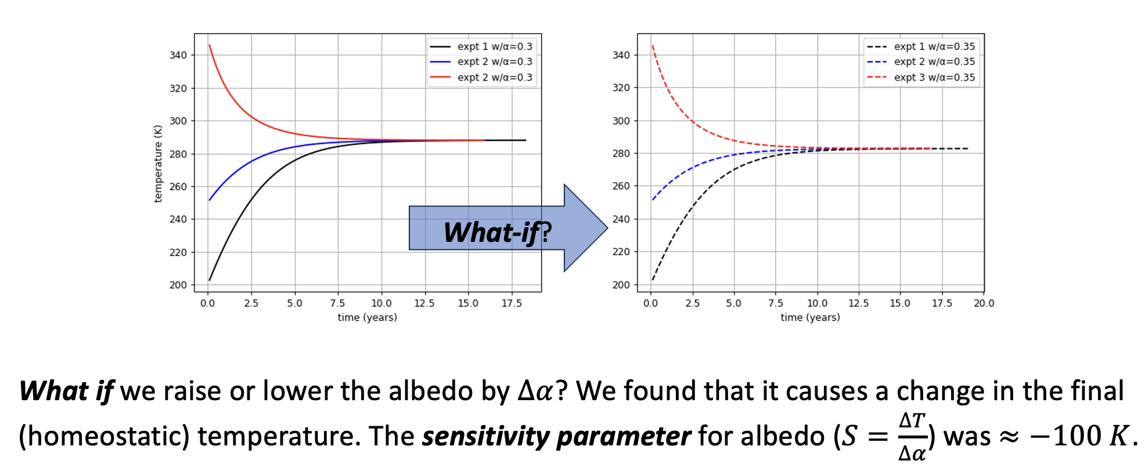
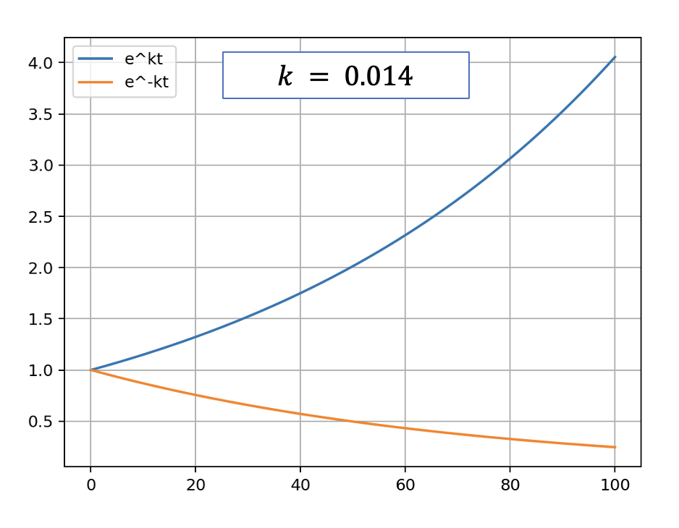
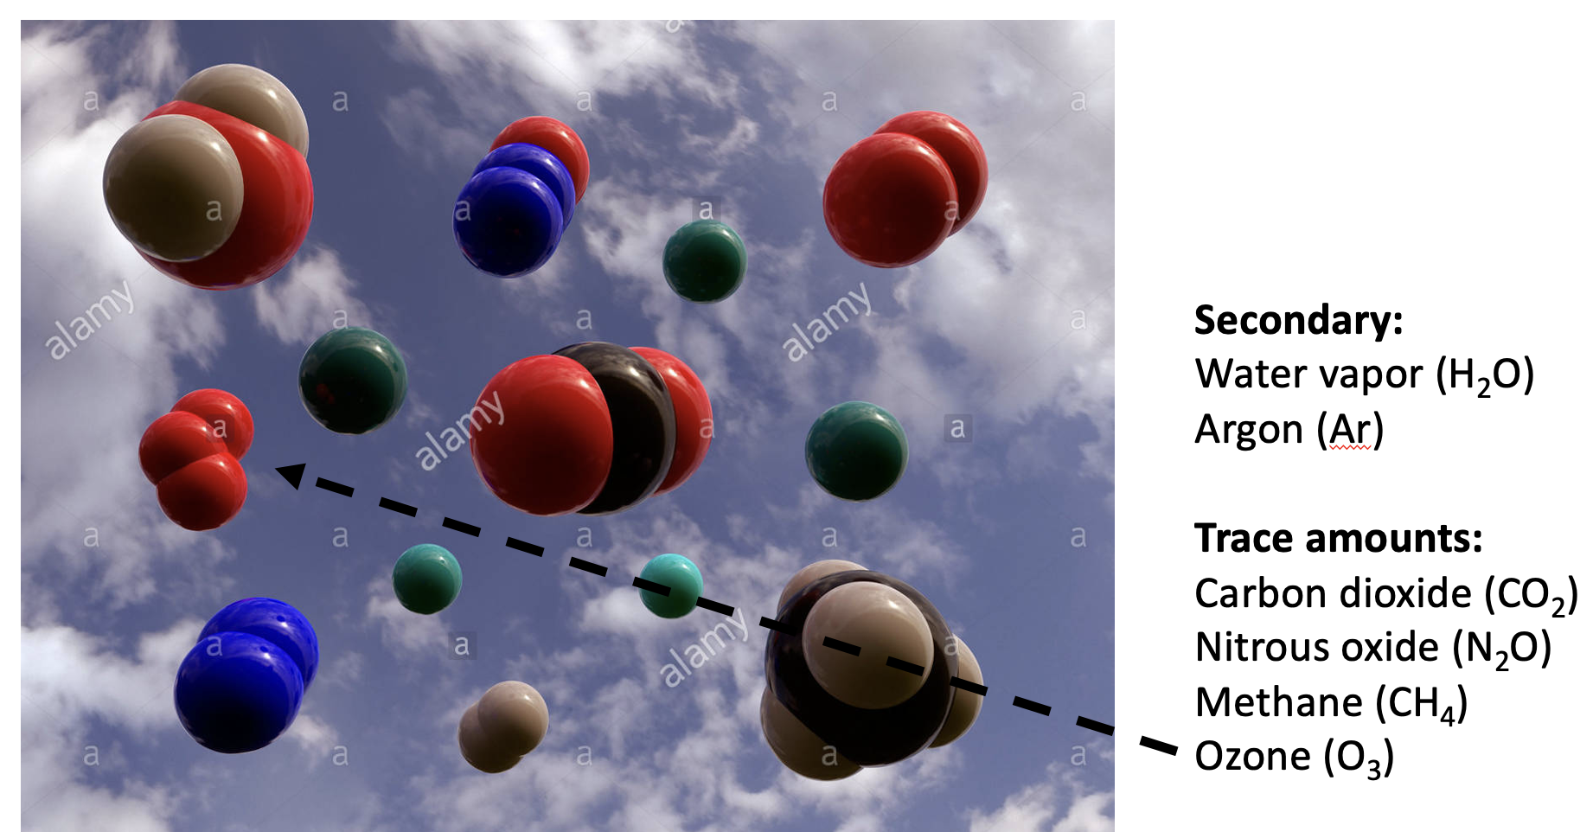
Last time, we talked about the format of the interviews, and some review …
See Week 6.1a (Monday) Interview preparation - format and tips
Today, we’ll be doing more of the same (filling in some gaps)

Slide 2
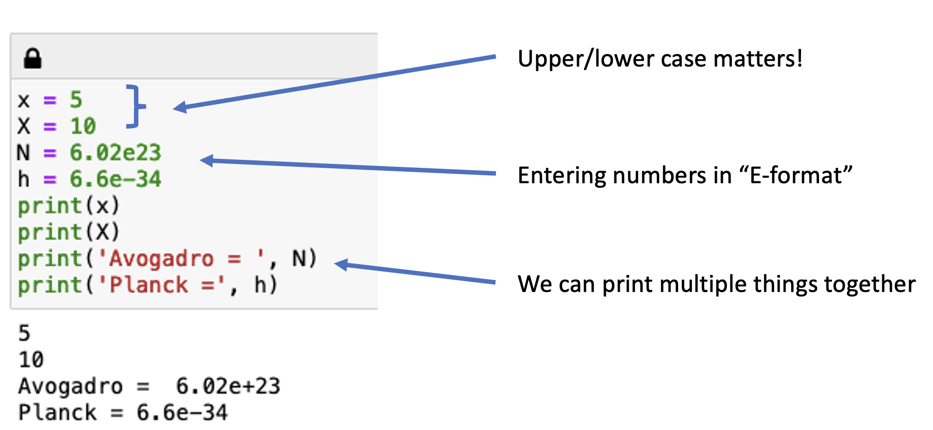
Week 1: We also got an introduction to key concepts of Python
Plus …
Order of operations
How to construct arrays with np.linspace
How to make graphs with labeled x- and y-axes

Slide 3
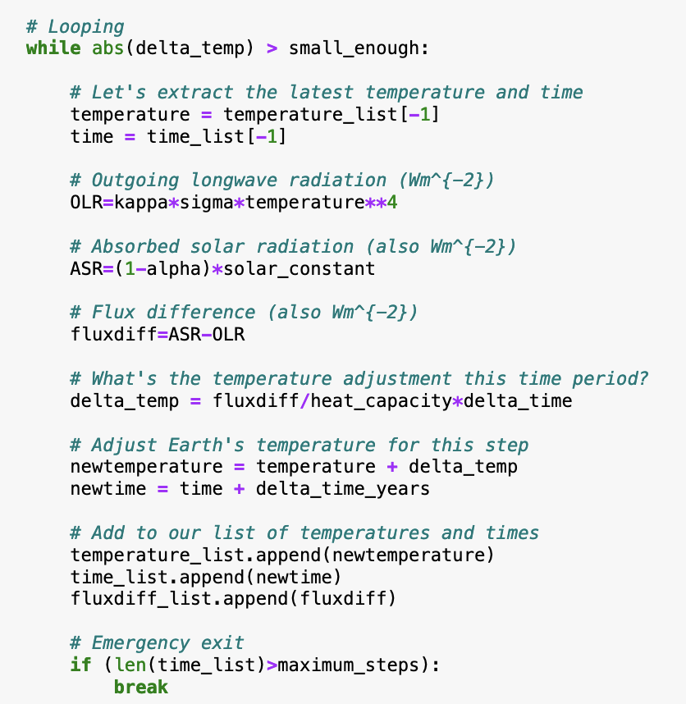

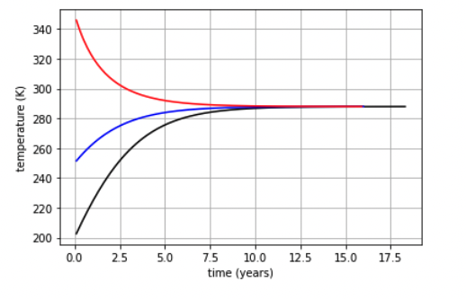
Week 2: SRB showed us how to construct a loop to predict the future

Slide 4
Week 2: We saw that shifts in semipermanent synoptic systems leads to ENSO variability
Nauru Low
Nauru Low
Chilean High
Chilean High
Upwelling water

Slide 5
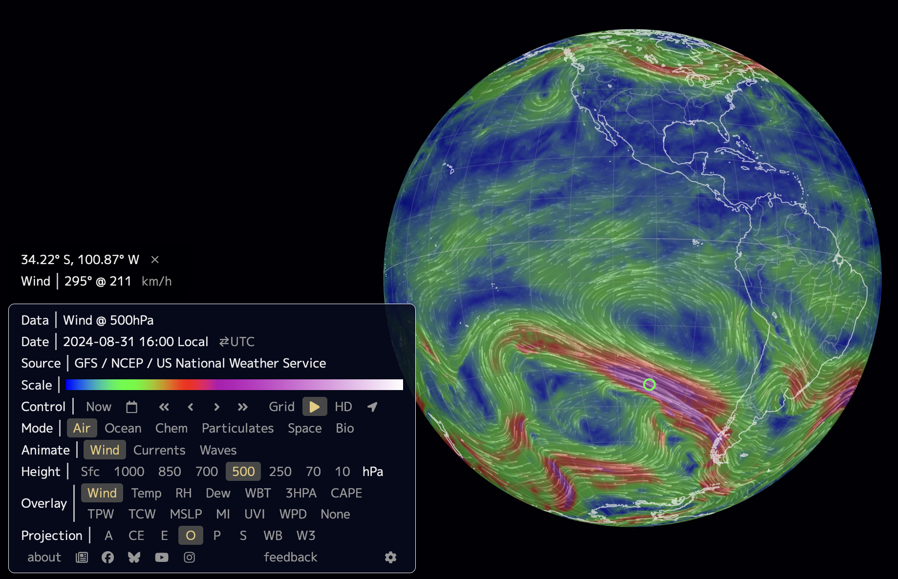
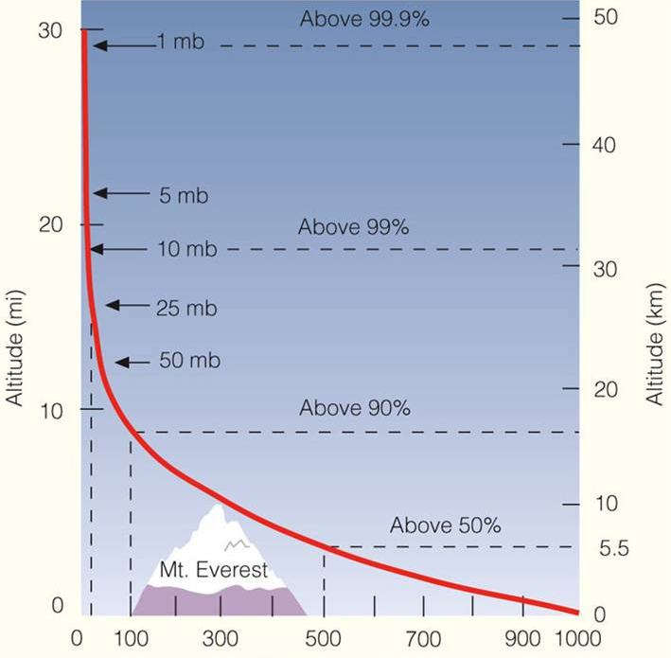

Week 2: We also learned about pressure as a function of altitude, and the “Rule of 5”
Pressure in $hPa$ (AKA mbar)
The “Rule of 5”: At $5.5 km$, the pressure is $50\%$of what it is at the surface ($500 hPa=500 mbar$), and $50\%$ of Earth’s atmosphere is below you.

Slide 6
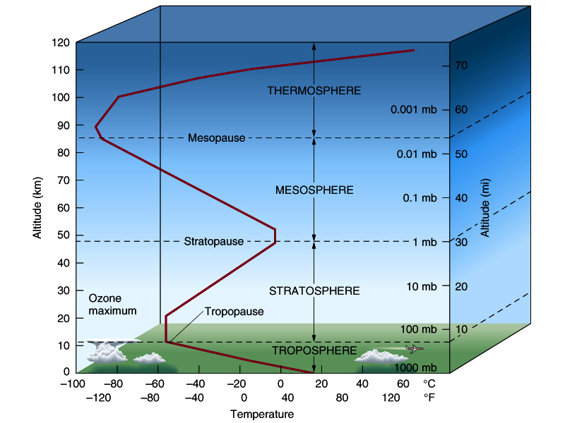
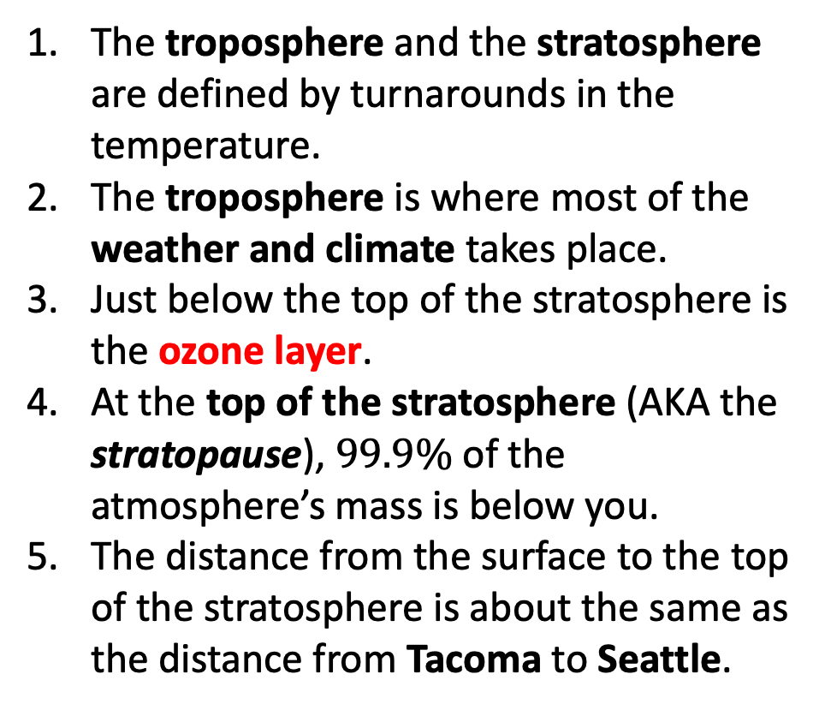
Week 2: And we learned how the troposphere and the stratosphere are defined
The troposphere and the stratosphere are defined by turnarounds in the temperature.
The troposphere is where most of the weather and climate takes place.
Just below the top of the stratosphere is the ozone layer.
At the top of the stratosphere (AKA the stratopause), $99.9\%$ of the atmosphere’s mass is below you.
The distance from the surface to the top of the stratosphere is about the same as the distance from Tacoma to Seattle.
Tacoma
Seattle

Slide 7
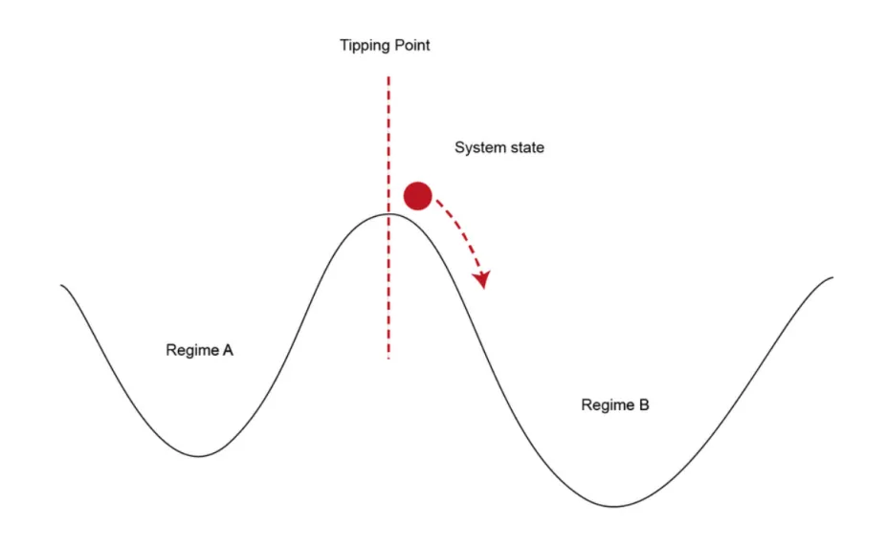
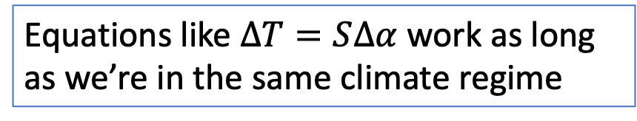
Week 3: We introduced the idea of climate forcings, and the importance of distinguishing perturbations that keep us in one climate regime, vs those that tip us over into another
As we get close to a new climate regime, even tiny forcings can send us over into it. Very difficult to predict where we’ll end up.
Small perturbations might change climate a little, but the results are still predictable
forcing
Equations like $∆T=S∆α$ work as long as we’re in the same climate regime
https://scied.ucar.edu/sites/default/files/styles/extra_large/public/images/tippingpoint_CC_rauter.png.webp?itok=jjVx9OvH

Slide 8
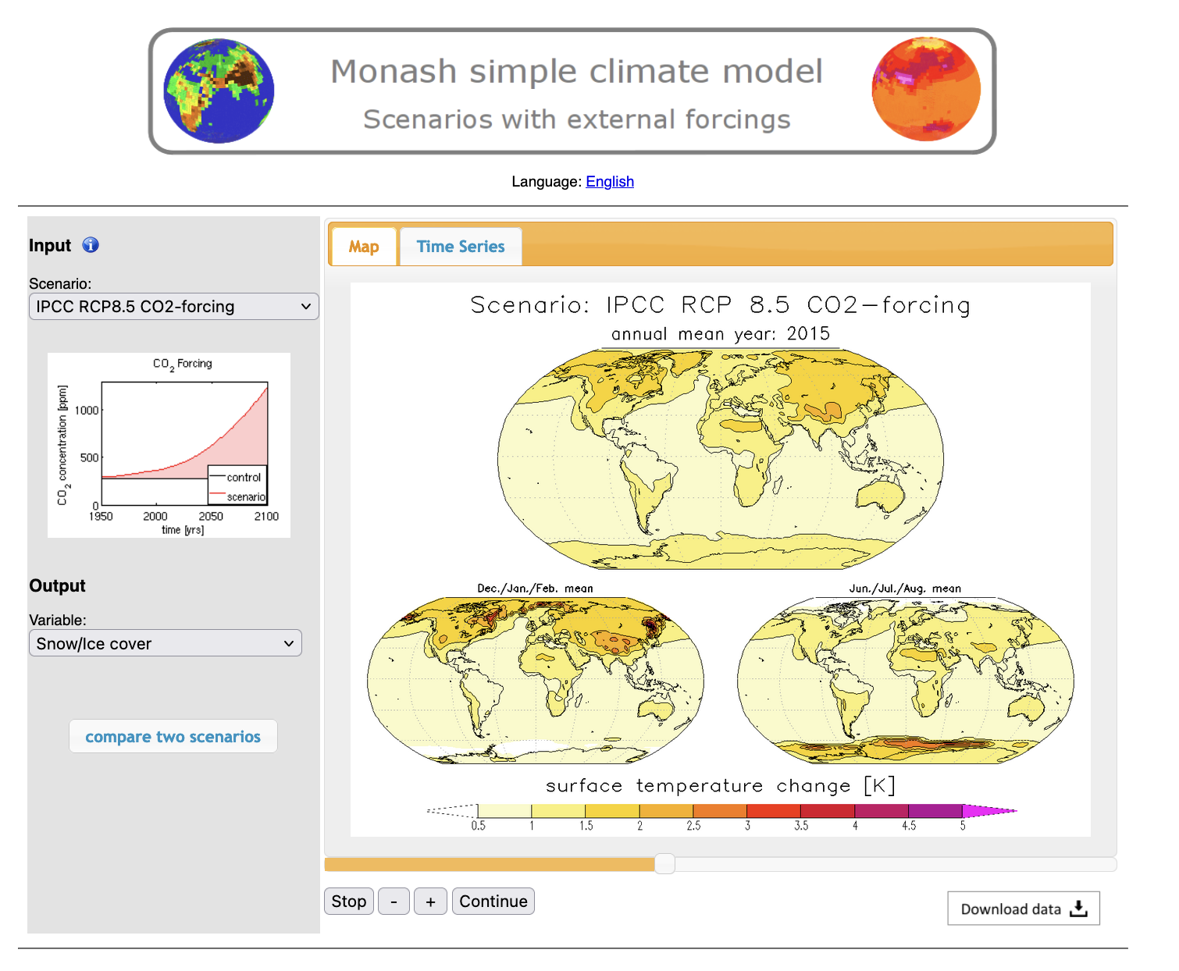
Week 3: Monash gave us geographic & temporal details about possible futures
What kinds of temperature increases might we be looking at?
What kind of impacts on snow/ice cover?
What parts of the world are warming faster than others?
Is the Equilibrium Climate Sensitivity built into these models reasonable?

Slide 9
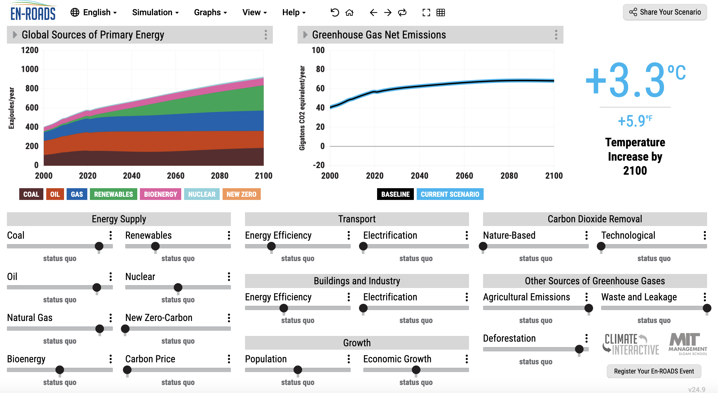
Week 3: EnROADs showed us possible routes to avoiding some of those possible futures

Slide 10
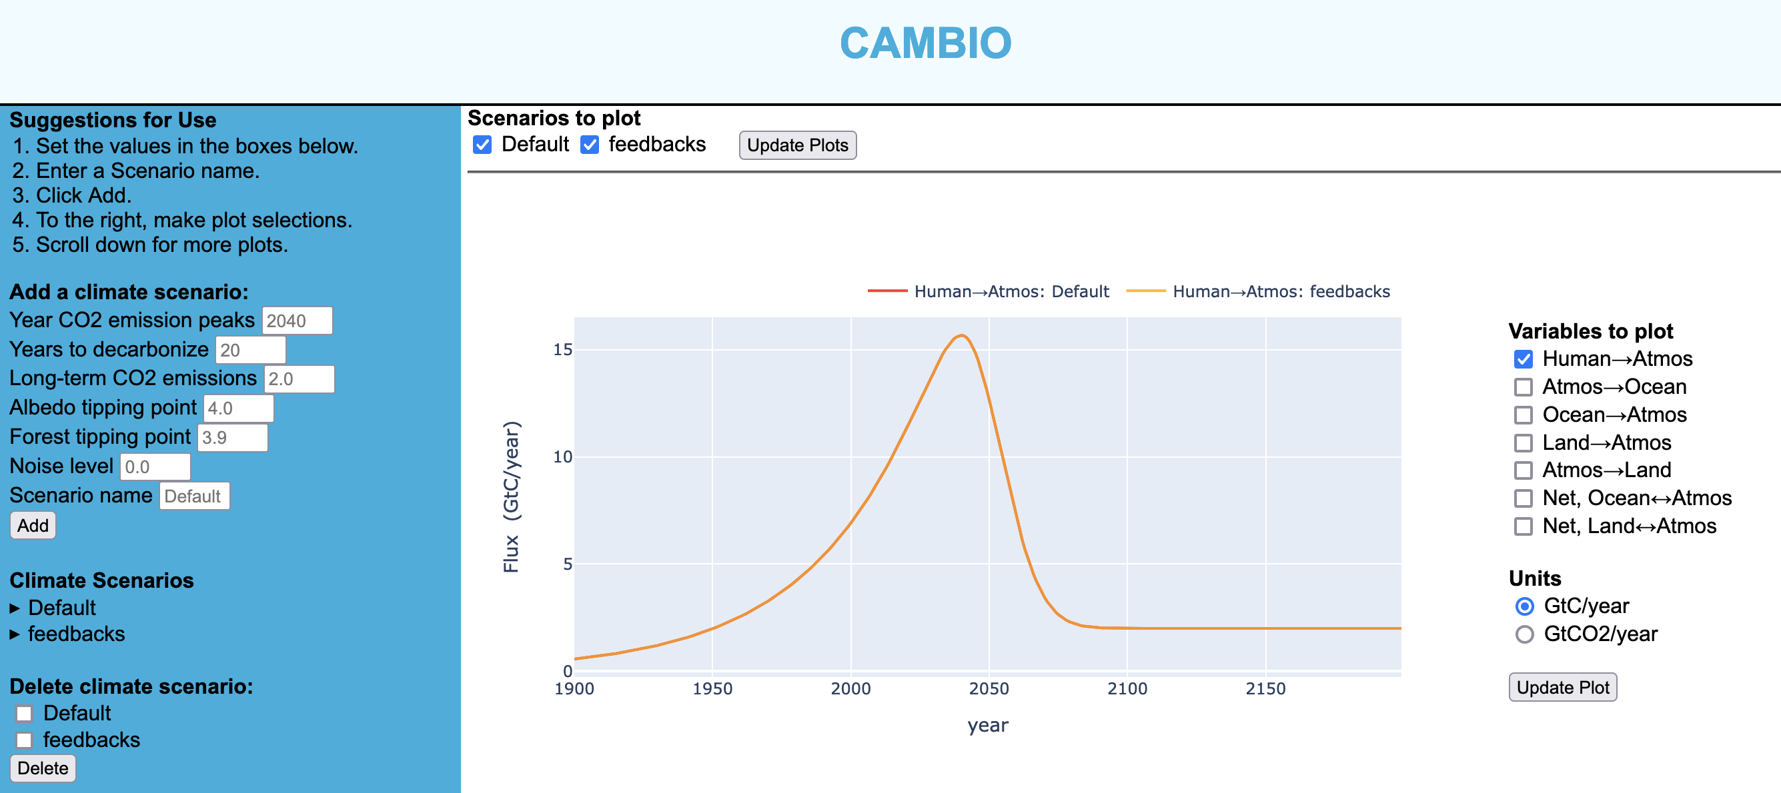
Week 3: We also got an introduction to the Cambio web app

Slide 11
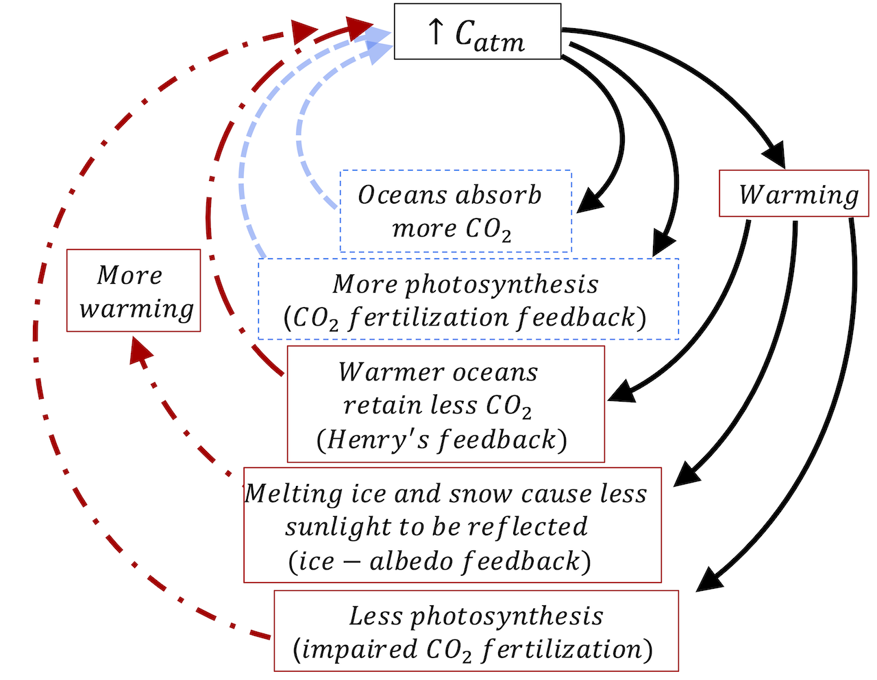
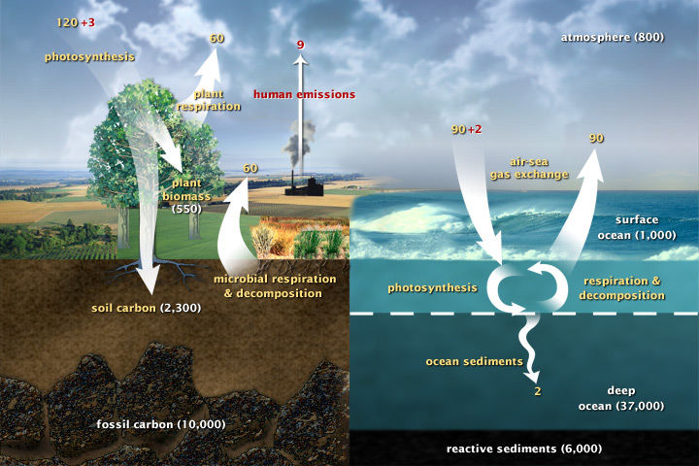
Week 3: We introduced feedback diagrams as a way to depict positive and negative feedbacks

Slide 12
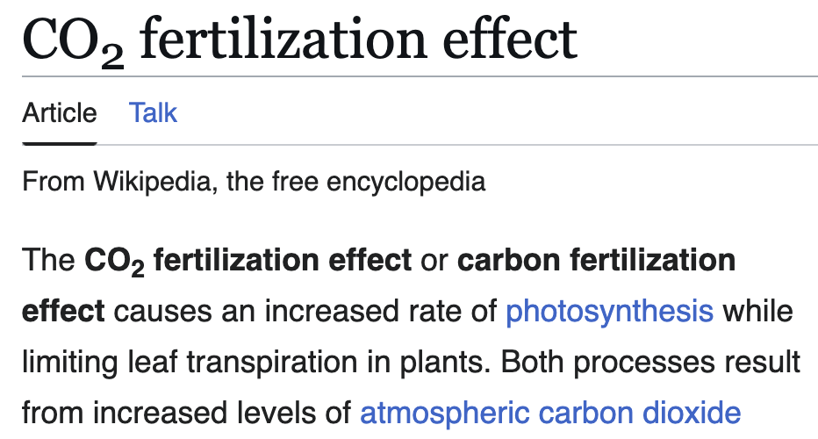
Week 3: We also learned about the CO2 fertilization effect

